Slide 1
The Evolution of Handwritten Digit Recognition
Wael Gazelle
INRTU
AIB-24

Slide 2
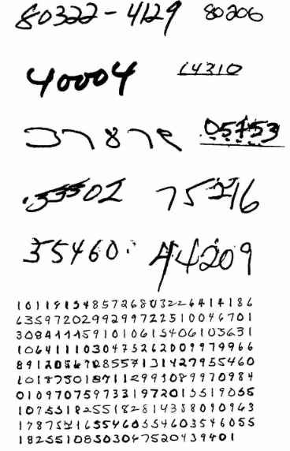
Why Was Handwriting Difficult for Computers?
Different people write the same digit differently.
Digits can be ambiguous: 3 vs. 8.
Handwriting varies in size, slant, shape, and position.
Systems often struggled with handwriting they had not seen before.

Slide 3
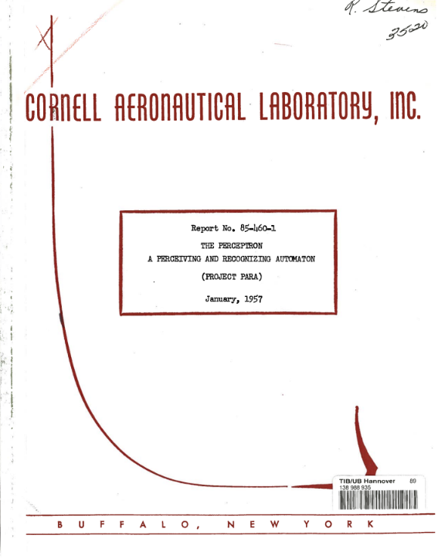
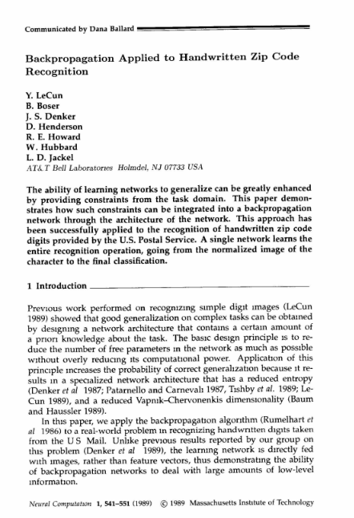
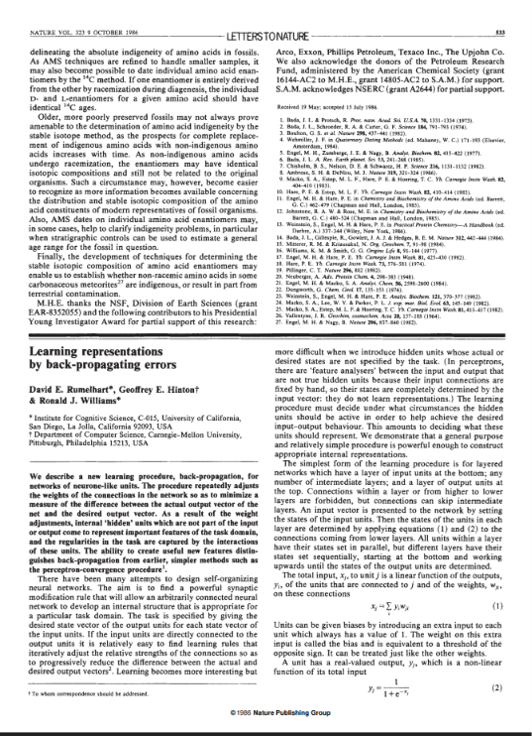
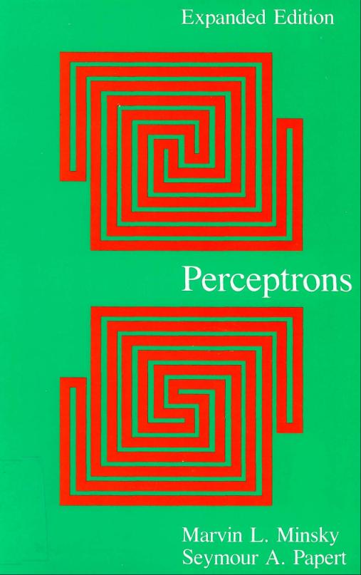
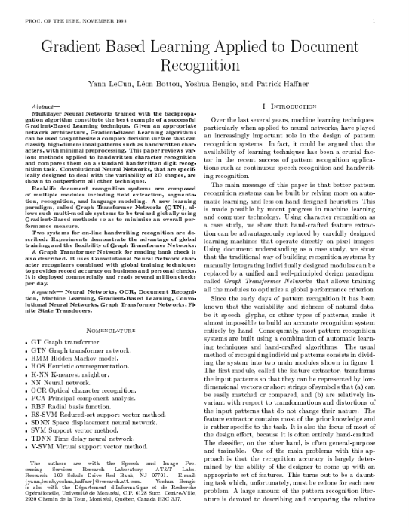
What Were the Old Solutions?
Manual reading:
People read and sort handwritten mail.
Rule-based systems: Programmers created rules based on strokes, loops, and character shapes.
Template matching: Computers compared new characters with stored examples.
Feature-based classification: Systems used manually designed measurements to classify characters.

Slide 5
Historical Background
1957 — The Perceptron (paper / archive search):
The Perceptron: A Perceiving and Recognizing Automaton. Early work on trainable pattern recognition.

Slide 6
Historical Background
1969 — Perceptrons (book / archive search):
An influential analysis of the limitations of simple perceptrons.

Slide 7
Historical Background
1986 — Learning Representations by Back-Propagating Errors.
Helped popularize backpropagation for training multilayer neural networks.

Slide 8
1969 — Perceptrons (book / archive search):
Authors: Yann LeCun, Bernhard Boser, John Denker, Don Henderson, Richard Howard, Wayne Hubbard, and Lawrence Jackel.
The problem: The U.S. Postal Service needed computers to recognize handwritten ZIP-code digits accurately.
What changed?
A neural network learned from labeled examples of handwritten digits.
The network received normalized character images and produced digit classifications.
Backpropagation adjusted the network's weights during training.

Slide 9
What Happened Between 1989 and 1998?
1990 — Continued development: LeCun and collaborators presented further work on handwritten ZIP-code recognition with multilayer networks.
LeNet development: Successive convolution and subsampling layers learned increasingly useful visual features. These ideas led to the LeNet-5 architecture.

Slide 10

Gradient-Based Learning Applied to Document Recognition(1998)
Authors: Yann LeCun, Léon Bottou, Yoshua Bengio, and Patrick Haffner.
What did the paper contribute?
LeNet-5: Presented a convolutional neural-network architecture using convolution, subsampling, and classification layers.
Learned visual features: The network learned increasingly complex patterns from image data.
Graph Transformer Networks: The paper described a way to connect multiple processing modules and train them toward an overall objective.
Integrated document recognition: The approach connected visual recognition with other stages, including segmentation and contextual processing.
Practical application: The paper described commercial bank-check reading systems operating at large scale.

Slide 11

Impact of the Two Papers
Postal automation: Learning-based systems helped automate the recognition of handwritten digits.
Banking: CNN-based recognition became part of systems used to read bank checks.
Learning features from data: Neural networks reduced reliance on manually specifying every visual feature.
Integrated processing: The 1998 work demonstrated the value of training multiple document-processing components toward a shared objective.
Influence on computer vision: CNN became an important foundation for later image-recognition systems.
2006 — Deep learning research.
2012 — AlexNet.

Slide 12

Conclusion:
Before: Manual reading, hand-designed rules, templates, and engineered features.
1989: Neural networks demonstrated learning-based recognition of real handwritten ZIP-code digits.
Between 1989 and 1998: CNN architectures developed and researchers worked toward more integrated document-processing systems.
1998: LeNet-5 and Graph Transformer Networks illustrated the potential of learned visual features and globally trained document systems.
Afterward: Continued advances in data, computing, and deep learning expanded neural networks.

Slide 13
Thank you for listening

